Slide 1

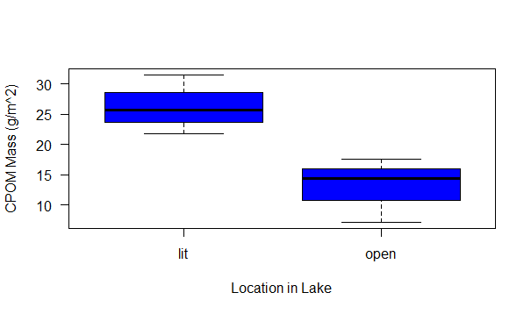
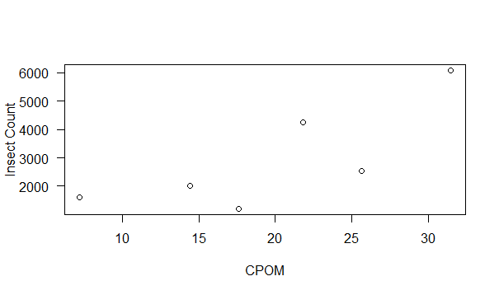
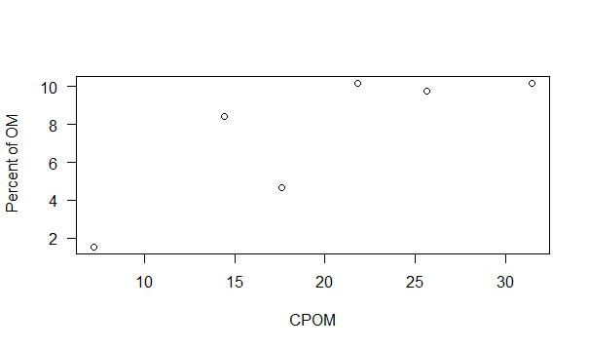
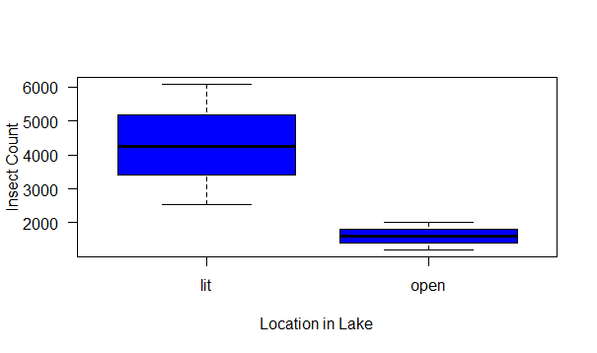
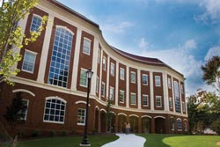
Longwood University
The effect of biodiversity on the storage of organic carbon in sediments of small ponds
Leanna Tacik, Carly Martin, and Dr. Kenneth Fortino ; Department of Biological and Environmental Science, Longwood University, Farmville, VA 23909
Introduction
Insect Count per CPOM Amount
The factors that control carbon cycling are key components in the ways the ecosystem responds to climate change. There is a gap in the knowledge of carbon cycling as to what role small ponds are taking in the carbon dioxide production and organic material storage. Small ponds store large amounts of organic carbon within their sediments due to the ability to capture organic material from surrounding watershed. Carbon remain in the lake sediments can be subtracted from atmospheric carbon , which can alleviate the effects of climate change; yet organic carbon that is washed into the lake is consumed by sediment microorganisms, the carbon will return to the atmosphere as carbon dioxide. The main objective of the study is to expand on previous findings, and measure the effect of sediment –dwelling insect function diversity on the rate of organic matter breakdown within the field. The manipulation of the functional diversity of sediment insect communities that are located in small chambers within the lakes, will allow the quantification of changes in sediment organic matter by calculating sediment oxygen demands. Expansion of our knowledge of how potential climate sensitivity factors affect upon insect communities’ composition control of the storage of organic carbon in lake sediments will occur with these findings. This study focuses on the difference among littoral and opem location in Wilkes Lake.
CPOM (g/m²) per Location in Wilkes Lake
Methods
The comparison of the insect count per CPOM amount shows exponential growth. Within a system the macroinvertabrates live off of FPOM, which is the broken down particles of CPOM. If there is more CPOM within an area, it is lead to believe that the insect count would increase due to more available resources.
Samples were collected from Wilkes Lake and Lancer Park Pond; at Wilkes Lake samples were collect to the east of the island and about 20m south of the shore. Lancer Park Pond samples were collect approximately in the middle of the lake and in the southwest corner of the pond about 1m from the south shore. Each field studied had littoral and open shallow samples, and three replicates of each sample were take with an Ekman dredge. Samples were placed in a plastic basin and homogenized gently. A sample of the homogenized sample was collected in a 20ml glass scintillation vial from each basin. The samples were washed through a 250μm mesh in the field and preserved in 70% ethanol.
In the lab CPOM was removed from the sample by being washed through a 1mm sieve. . From the CPOM, macroinverterbrates that retained with the coarse fraction were removed by picking without magnification in a basin. The macroinvertebrates collected in the fine fraction were removed under a dissecting scope from the sediment. Organisms were taken from the scintillation vials and washed through a 250μm mesh sieve. From the sieve they were transported to a petri dish with a small amount of water to be sorted and counted. The insects were identified into the ceratopogonida family, chironomidae subfamily, or genus chaoborus. Oligochates that were found occurred mostly as fragments, and they were not identified or quantified. All organisms were transferred back into original scintillation vials and preserved. All samples were restored at 70% ethanol.
Wilkes Lake material that was retained was dried in a pre-weighed weight boat at 50_{o} C for approximately 48h before massing. Lancer Park Pond material was collected in a pre-weighed paper lunch bag and dried for approximately 48h before massing. The samples collected in the scintillation vial were dried at 50_{o} C until processed for LOI. This sample was processed for LOI by transferring a majority of the sample to a pre-weighed ceramic crucible and then being ashed at 550_{o} C for 4h and 5m. The sample was removed and weighed before they cooled to room temperature.
Comparison of OM Percentage and CPOM
Insect Count per Location in Wilkes Lake
Acknowledgement
The littoral area of Wilkes Lakes had higher species richness than the open area; there was more variation within the littoral. The littoral having more species richness of insects correlates to the area having a high CPOM average compared to open area.
We thank Longwood University’s Cook-Cole Fund and the Department of Biological and Environmental Science for financial support and instrumentation.
(1) Colwell, R. "Biodiversity: Concepts, Patterns and Measurement". The Princeton Guide to Ecology. Princeton: Princeton University Press. pp. 257–263. (2009). (2) Koljonen, S. Quantifying the effects of in-stream habitat structure and discharge on leaf retention: implications for stream restoration no access. Freshwater Science, 31(4), 1121-1130. (2012). (3) Kominoski, J. "Conservation from the bottom up: forecasting effects of global change on dynamics of organic matter and managemen needs for river networks." Freshwater Science. (2012). (4) Vaughn, C. "Biodiversity Losses and Ecosystem Function in Freshwaters: Emerging Research Directions." BioScience. 60. no. 1 (2010). (5) Yoshimura, C.. Instream release of dissolved organic matter from coarse and fine particulate organic matter of different origins. Biogeochemistry, 100(3), 151-165. (2010)

